Slide 1
Veteran Research Study XX
by XX

Slide 2

Introduction to Research
CHERP Intro (include CHERP logo)
  VA’s National Center for Health Equity Research and Promotion (CHERP), founded in 2001.
    Two-sites, Pittsburgh and Philadelphia
    Reduce disparities in health outcomes for vulnerable Veteran populations
    Partnerships to implement findings in clinical care
    Staff training and development
    www.cherp.research.va.gov

Slide 3
Introduction to Research
Why this research is important to the Veteran.
Why this research is important to the clinical staff.
What method is being used to gather data?
  Qualitative
  Quantitative
  Both
  Why?
Additional Resources

Slide 4
Introduction to Study XX
Study objective
Parameters of the study
Study timeframe and dates of funding
Study background

Slide 5
Preliminary Findings/Abstract Findings
If this study is in progress, any important information to show its effectiveness should go here.
  Qualitative findings
  Quantitative findings
  Abstract of findings

Slide 6
Research and Clinical Team Coordination
Clinical staff can expect frequent communication from the research team throughout the course of study.
  Initial study introduction
  Recruitment check-points (via phone, email?)
  Research findings shared with conclusion of study
  Feedback on research recruitment
Best way to communicate with research team.
  Phone numbers, emails, etc.

Slide 7
Best practices for recruitment introduction (Examples of Best Practices below)
Use language that supports the strength of the Veteran and their experiences
Remind Veterans that their participation in research will not affect their VA Benefits in ANY WAY.
“Because of your experiences, I can see you have incredible resilience to adversity. That must have been hard, but you are doing an excellent job. If you feel comfortable, I know of a study that could really benefit from your experience with...and it would help other Veterans because... Would you be comfortable with me introducing you to a member of the research team? Her/his name is...and she/he has also experienced...”
Preferred method of communication vs method of communication with which Veteran is most comfortable/has access.

Slide 8
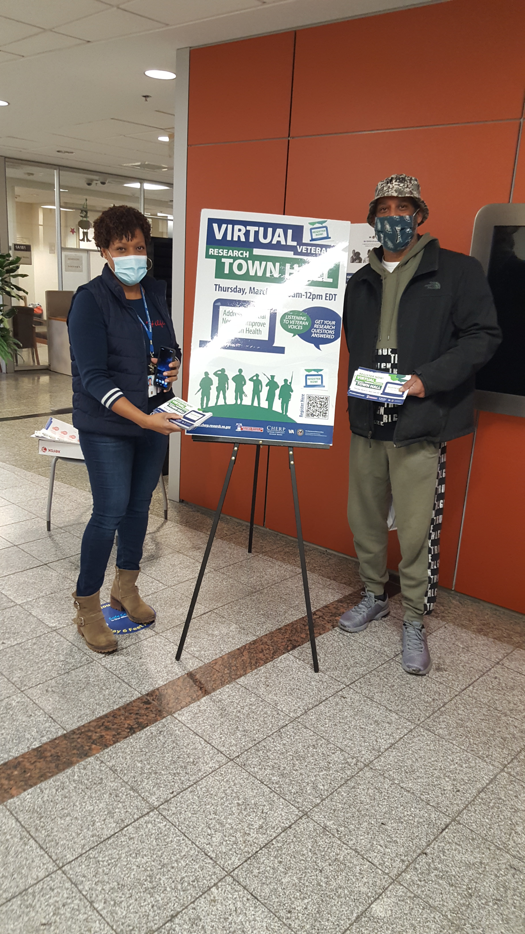
Additional Information about Recruitment Tools
Flyers, Ads
Email
Word of Mouth
Trauma informed video
PAO, research team contacts
Assistance needed from clinical staff

Slide 9
Questions
Conclusion
  Recap of background objective, timeframe, method of research
  CTA, if applicable from clinical staff
Questions
Thank you for your time.

